Slide 1
IOT Based Air Pollution Monitoring System Using GSM Module
K.Venkata Ramana
M.Geetha Sri
I.Ramu
P.Sathish
Project Guide :
P.S.D Anvesh Sir

Slide 2
Abstract:
Air pollution is one of the most serious problems faced by the world today.
Rapid industrialization, urbanization, and increased use of vehicles have significantly contributed to the rise in harmful gases in the atmosphere.
Traditional methods of monitoring air quality are often expensive, complex, and not suitable for continuous real-time monitoring.
To overcome these limitations, the use of Internet of Things (IoT) technology.

Slide 3

Introduction & problem statement :
1
Air pollution is increasing day by day.
It affects human health and the environment.
Polluted air can cause breathing and heart problems.
Existing air pollution monitoring systems are costly.
Manual monitoring is difficult and time-consuming.

Slide 4
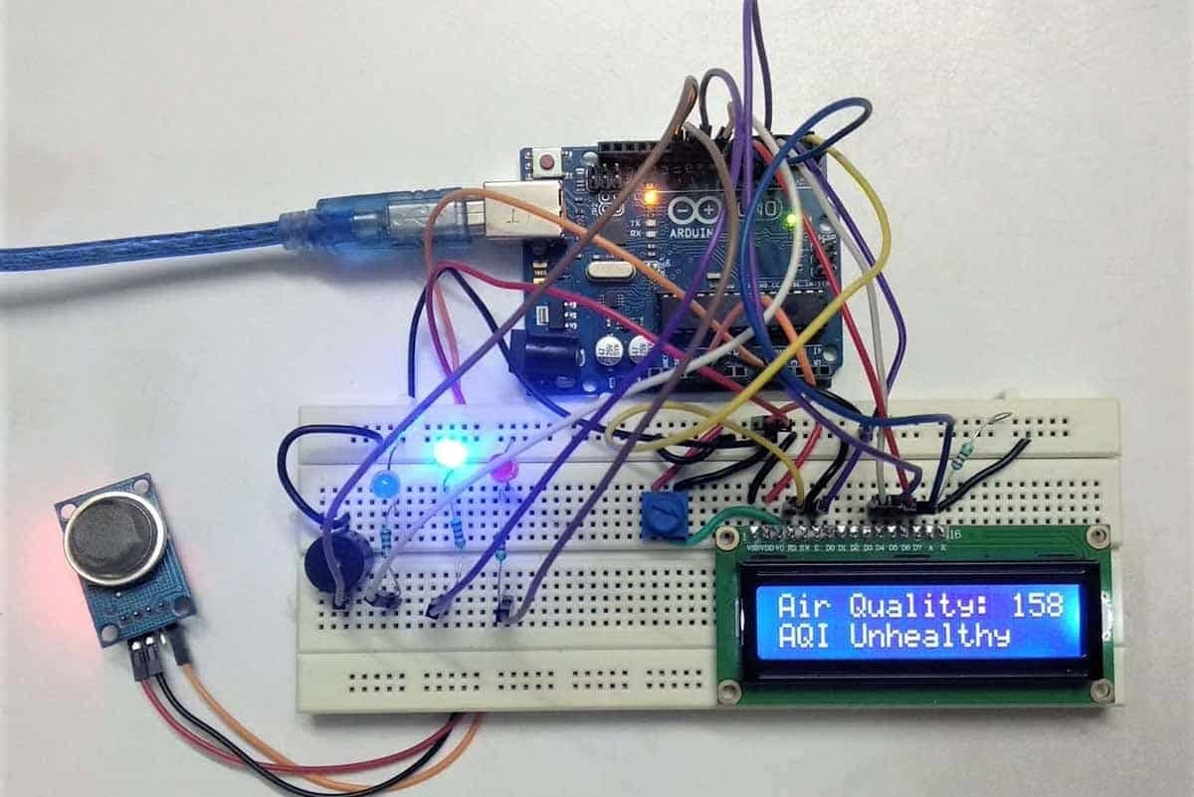
Existing system Using Arduino UNO R4 Wi - Fi :
2
Built-in Wi-Fi for internet connectivity
Uses MQ-9
Displays data on 16 × 2 LCD
Sends data through Wi-Fi network
Supports cloud monitoring
Does not use GSM module
Requires Wi-Fi availability

Slide 5
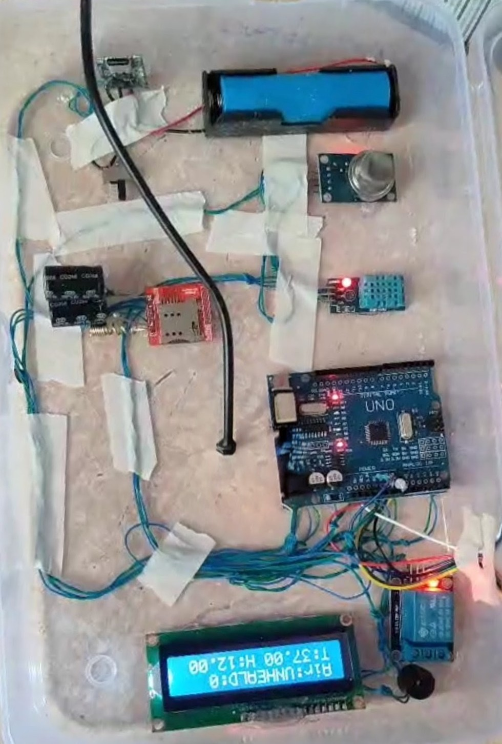
Proposed System Using GSM Module :
3
Arduino UNO as controller
DHT 11 for temperature and humidity
MQ-9 for CO gas detection
PM2.5 for dust measurement
16 × 2 LCD for display
GSM module for SMS alerts
Buzzer for warning

Slide 6
Block Diagram :
4
OUTPUT & COMMUNICATIONS
INPUT SENSORS
DHT - 11
16 * 2 LCD Display
ARDUINO UNO
Controller
MQ - 9
(CO & CH4 ...)
GSM Module
BUZZER
PM2.5
Power Supply Board

Slide 7
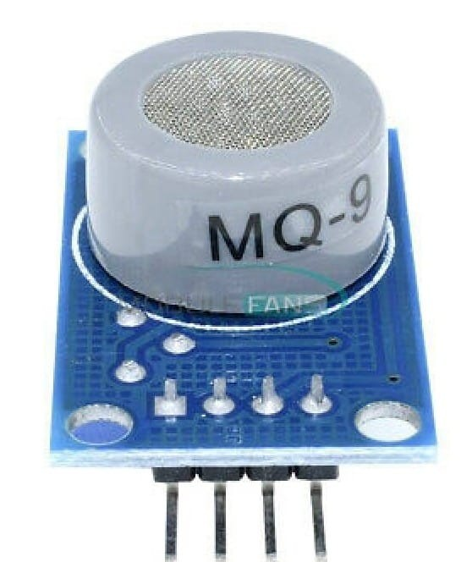
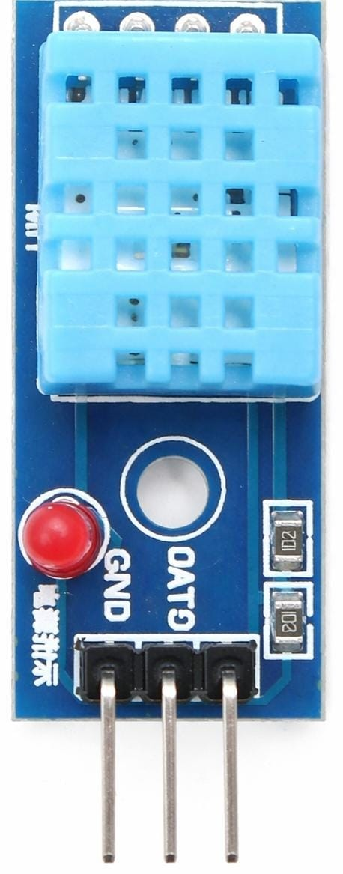
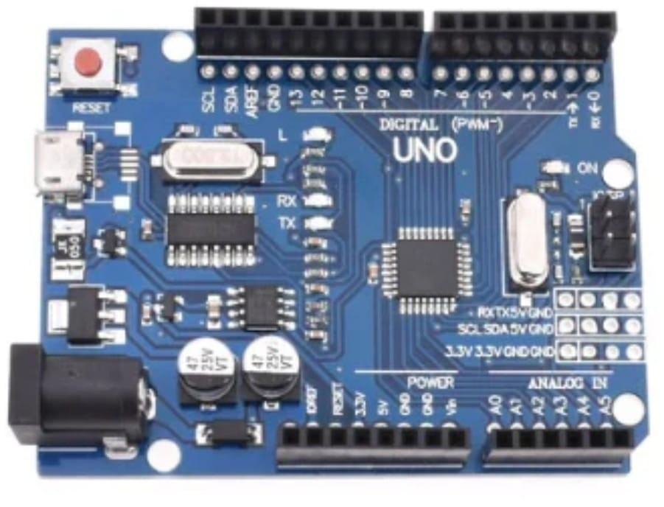
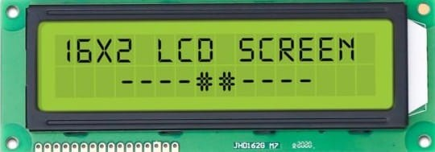
List of Required Hardware Components :
5
DHT11
MQ-9
PM2.5 sensor
16x2 LCD
Power Supply
Arduino UNO
SIM800 GSM Module
Buzzer
MQ-9
DHT 11 Sensor

Slide 8
Comparison:
6
EXISTING SYSTEM :
1. Depends on Internet (Wi-Fi Required)
2. Uses limited Sensors (MQ-9)
3. Data sent to cloud/server
4. Fails if internet is Unavailable
5. No Direct alert system
PROPOSED SYSTEM :
1. Works without internet using GSM
2. Uses multiple sensors (MQ-9, PM2.5, DHT11)
3. Sends SMS alerts direcly to user
4. Works in remote areas without internet
5. Insstant SMS + buzzer alert system

Slide 9

Real Time Example (Vizag Gas Leak Incident-2020) :
7
Date: May 7, 2020
Location: Gopalapatnam, Visakhapatnam (Vizag)
Cause: Leakage of Styrene gas from LG Polymers plant
Impact:
10+ deaths
1000+ people affected
Breathing issues, unconsciousness, panic in nearby areas

Slide 10
Advantages Disadvantages
8
Provides real-time air quality monitoring
Sends SMS alerts using GSM module (no Wi-Fi required)
Buzzer gives immediate warning
Low-cost and easy to implement
Portable and simple circuit design
Depends on mobile network signal (GSM)
SMS alerts may have delay
Power consumption increases with GSM module

Slide 11
Applications Future Scope
9
Home air quality monitoring
Industrial gas leakage detection
- ( Vizag [ LG Polymers ] )
Smart city pollution monitoring
Schools.
hospitals.
office safety monitoring.
Add Wi - Fi / LoRa backup
Cloud data storage and analysis
GPS-based pollution tracking system
Solar-powered outdoor monitoring system
AI-based pollution prediction and smart alerts

Slide 12
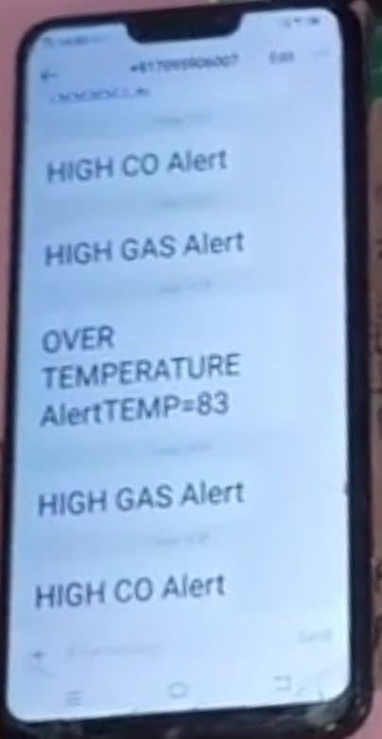
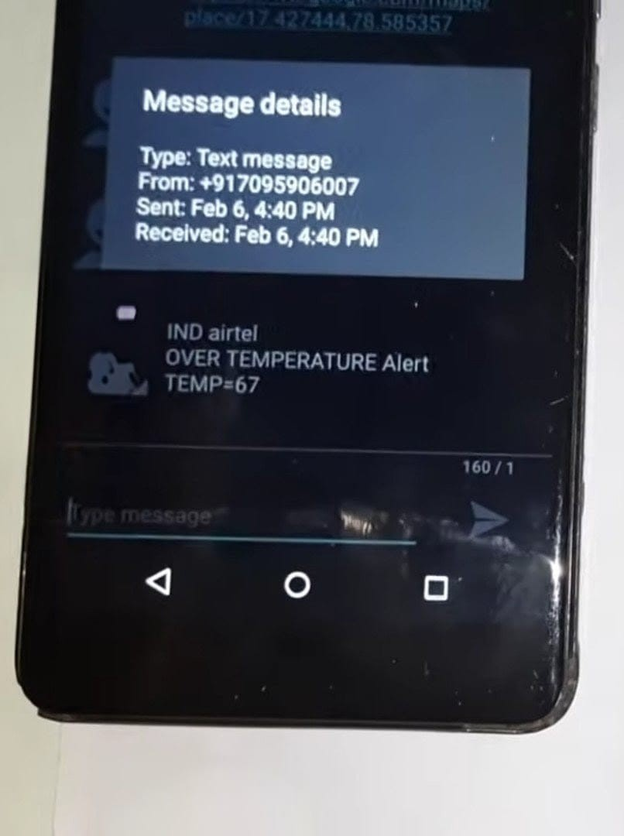
Results :
10
Successfully monitors temperature, humidity, CO, and PM2.5 levels
Displays real-time data on LCD
Sends SMS alerts during high pollution conditions
Detects over temperature and high gas levels
Automatically turns ON Buzzer during dangerous conditions.

Slide 13
Conclusion :
11
Low - cost and Efficient air pollution monitoring System Developed.
Successfully Monitoring Multiple Environmental Parameters
Provides Real - Time Alerts Using GSM Technology.
Works without Internet , Suitable For remote areas

Slide 14
THANK YOU
FOR YOUR TIME AND ATTENTION

